Slide 1
6th Grade Science
Interactive
Science
Notebook

Slide 2
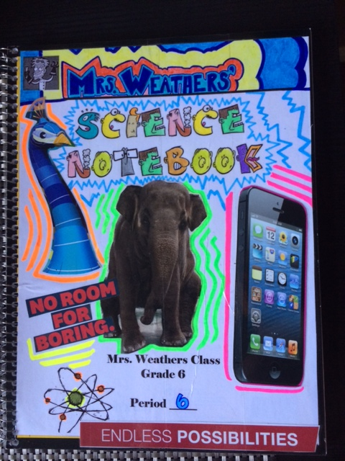
Today you will receive and set up your interactive science notebook.

Slide 4
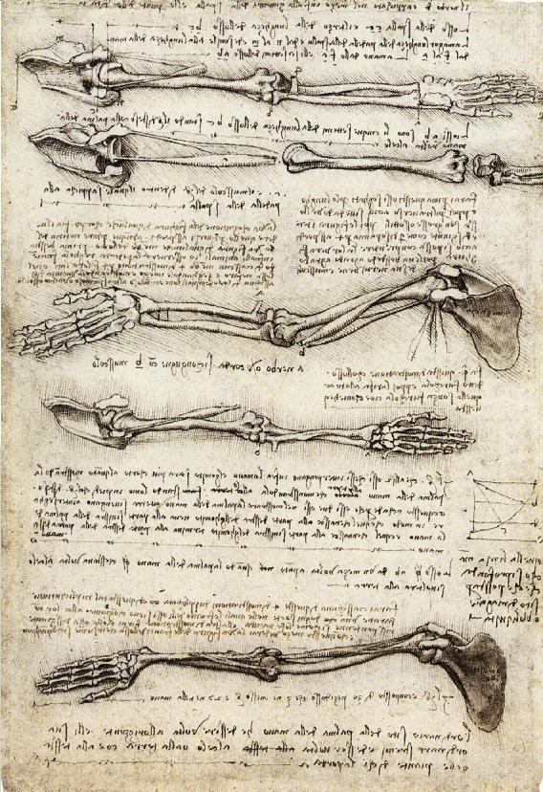
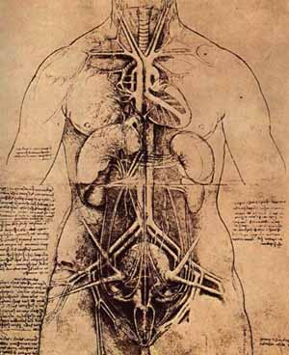
Real scientists use notebooks…
Check out Leonardo da Vinci’s

Slide 5
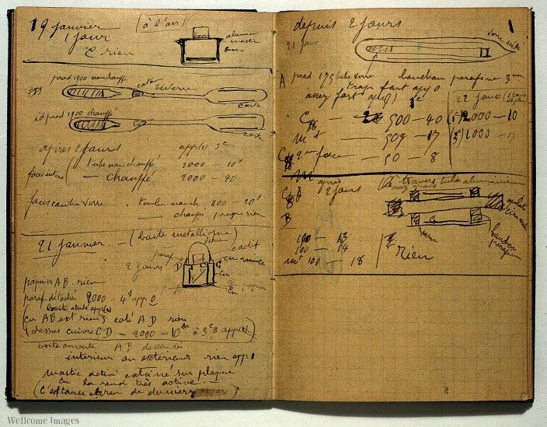
Real scientists use notebooks…
Marie Curie’s notebook is still radioactive from all of her experiments on radioactivity

Slide 6
Our notebooks will be organized
LEFT SIDE
-cartoons/drawings
-raps/poems/songs
-analysis
-graphic organizers
Anything going on the left side will have this symbol

Slide 7
Odd pages=1,3,5,7,9…
LEFT SIDE
If you finish your assigned work early,
work on one or more of the following prompts on the left side of your journal to dig deeper into our work .

Slide 8
Left side activities

Slide 10
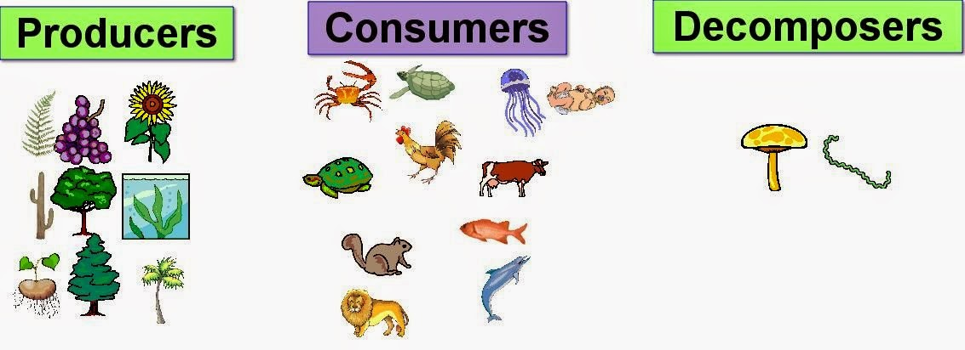
Left side might look something like this
BOCA #1
9/10/2015
Fill in the missing word.
Decomposer producers consumers
Plants are _____________________. Lions, tigers, and bears are __________________. Worms and mushrooms are __________________.

Slide 11
RIGHT SIDE
Things from the teacher go here.
Anything going on this side will be marked with this symbol

Slide 12
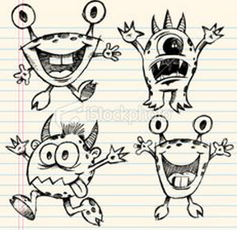
No doodles or drawings on this page…only what the teacher gives you!

Slide 13
Examples of right side input

Slide 14
I’ll give you all of your supplies…

Slide 16
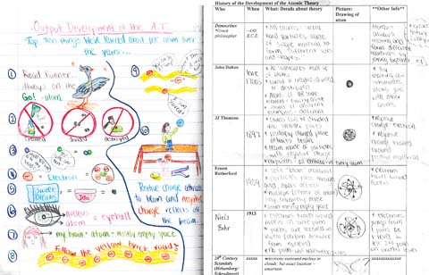
What you need to know…
Your notebook will also be your study guide.
Your notebook will count for a large part of your grade
Your notebook will be graded. If you miss anything, make sure you catch up.
Keep it neat, organized, and FILLED with great scientific observations and data!

Slide 17
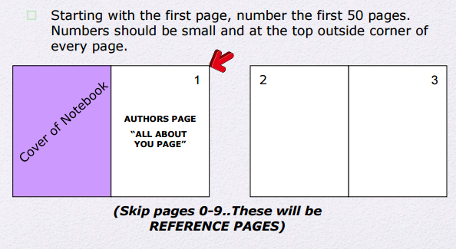
Back of cover
Open Response Questions
Open Response Questions
Notebook
Grading Rubric
Table of contents
Table of contents
Left/Right side
info

Slide 18
4
5
6
7
“What is science?” activity
“Scientific Method” Notes

Slide 19
COVER ASSIGNMENT RULES
You must use the cover sheet given to you (fill out first and last name & period)
You may use colored pencils and pencils ONLY… NO MARKERS!!
Use school appropriate images, pictures, or cut outs that represent YOU, your interests, hobbies, etc. (3-6)
Try to find images that represent SCIENCE to you. (1-2)

