Slide 1
Unit 1: Narrative
Flash Narrative:
Let’s look at message, spelling, and punctuation…
Ingredients for a stellar story!

Slide 2
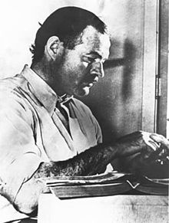
So what’s the story?
It has been told that Ernest Hemingway was challenged by a close friend to write a narrative in under ten words. Hemingway got it down to six.

Slide 3
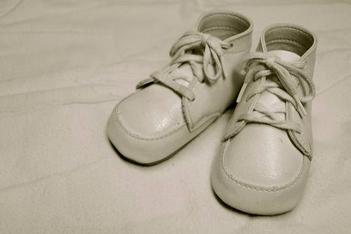
Ernest Hemingway
For sale: Baby shoes. Never worn.

Slide 4
Ernest Hemingway
In your journal, on the page titled, “What is a narrative,” please write a short evaluation of this sentence.
In your words, what does this story mean??

Slide 5
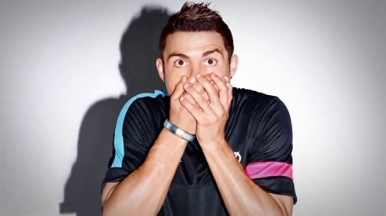
Other Examples
-Ashley Betteridge
I didn’t think you’d find out!

Slide 6
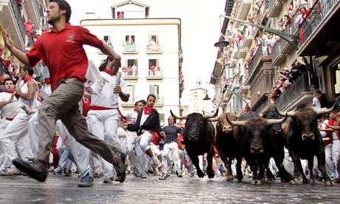
Other Examples
Shelby Moran
Something is coming for me…HELP!

Slide 7
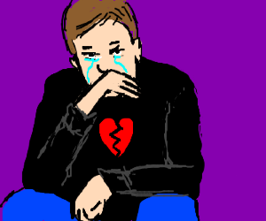
Other Examples
He had everything, except for her.
Michelle Bourgeois

Slide 8
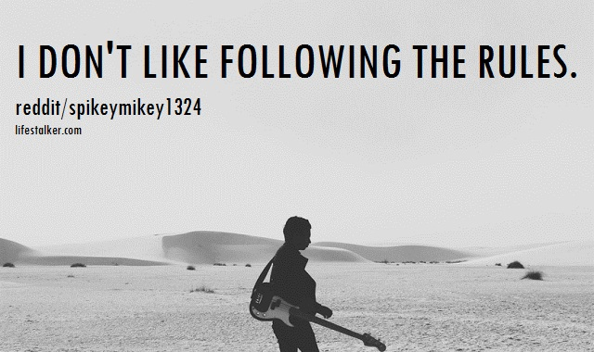
Other Examples

Slide 9
Other Examples
Ann Oro
He bottle feeds his wife’s killer.

Slide 10
Guidelines
A Six-Word Story should provide a movement of conflict, action, and resolution that gives the sense of a complete story transpiring in a moment’s reading.
Take a look at Hemingway again, what can you infer from only six words?
For sale: Baby shoes. Never worn.

Slide 11
Editing and Revising
Editing and revising are an important part of the writing process that we will be using this year. Why is proofreading your work important? Check out some of the embarrassing mistakes that could have been prevented on the next slides if someone had only taken a moment to proofread their work.

Slide 12
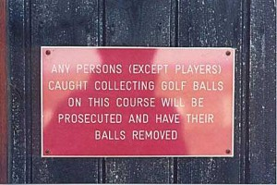
Editing and Revising
Word Choice- What is wrong with these two pictures? Have you made sure to say exactly what you want to say? Double check!

Slide 13
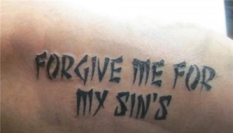
Editing and Revising
Punctuation- Punctuation can change the meaning of a statement when done incorrectly. Can you point out the mistakes in the two pictures?

Slide 14
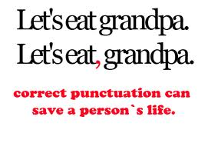
Editing and Revising
Punctuation- Punctuation can change the meaning of a statement when done incorrectly. Can you point out the mistakes in the two pictures?

Slide 15
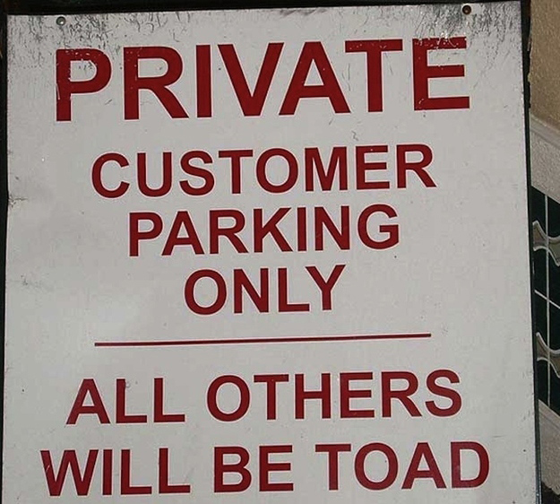
Editing and Revising
Uh oh!! Here’s a real-life example:

Slide 16
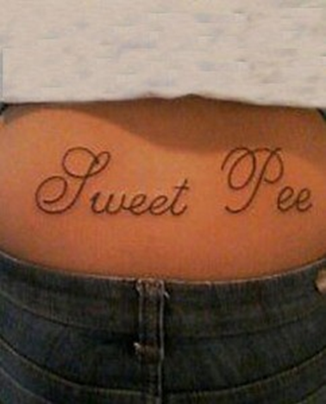
Editing and Revising
Spelling- Use a spelling dictionary if you are unsure how to spell something or ask your partner. Also, homophones can be tricky at times. Discuss the mistakes in the following pictures.

Slide 17
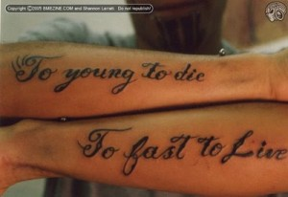
Permanent :/

Slide 18
Oh no!

